Slide 1
“We were always doing something outside. … I had a wonderful, wonderful life”: U.S. Indigenous peoples’ subsistence, physical activity, and the natural world
Catherine E. McKinley

Slide 2
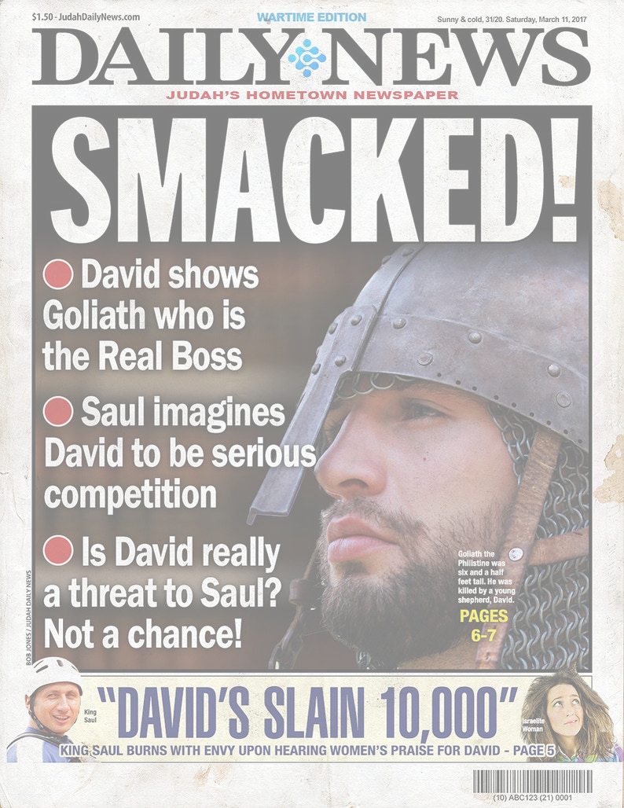
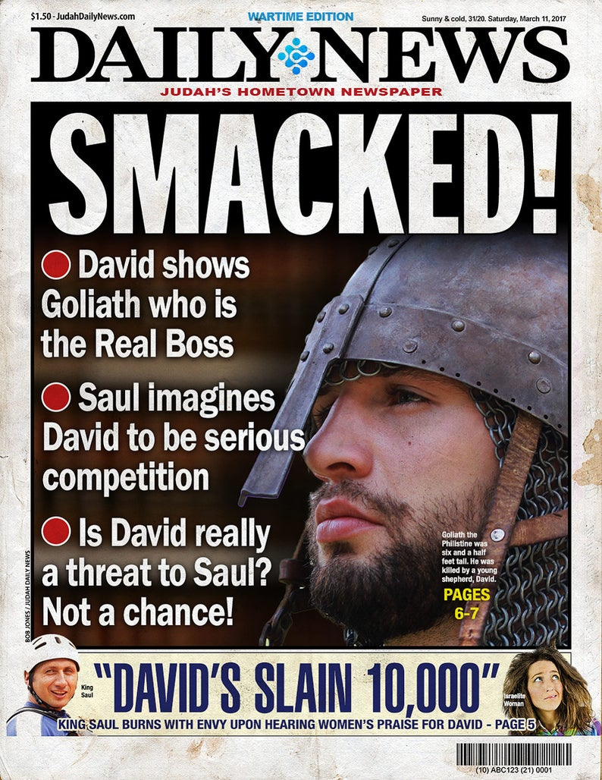
The article is about how the author used qualitative methods to study how Indigenous people in the US engage in physical activity. It's a good article.

Slide 3
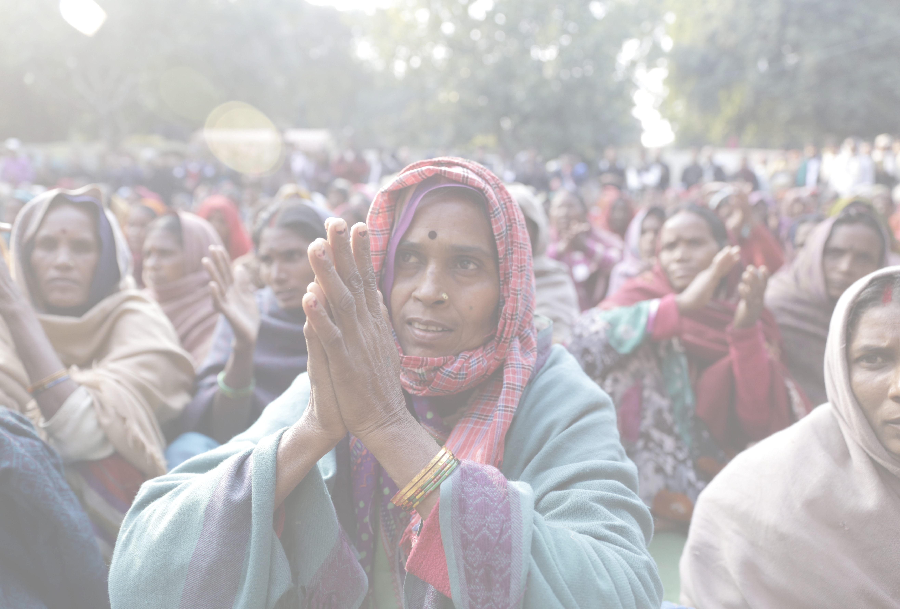
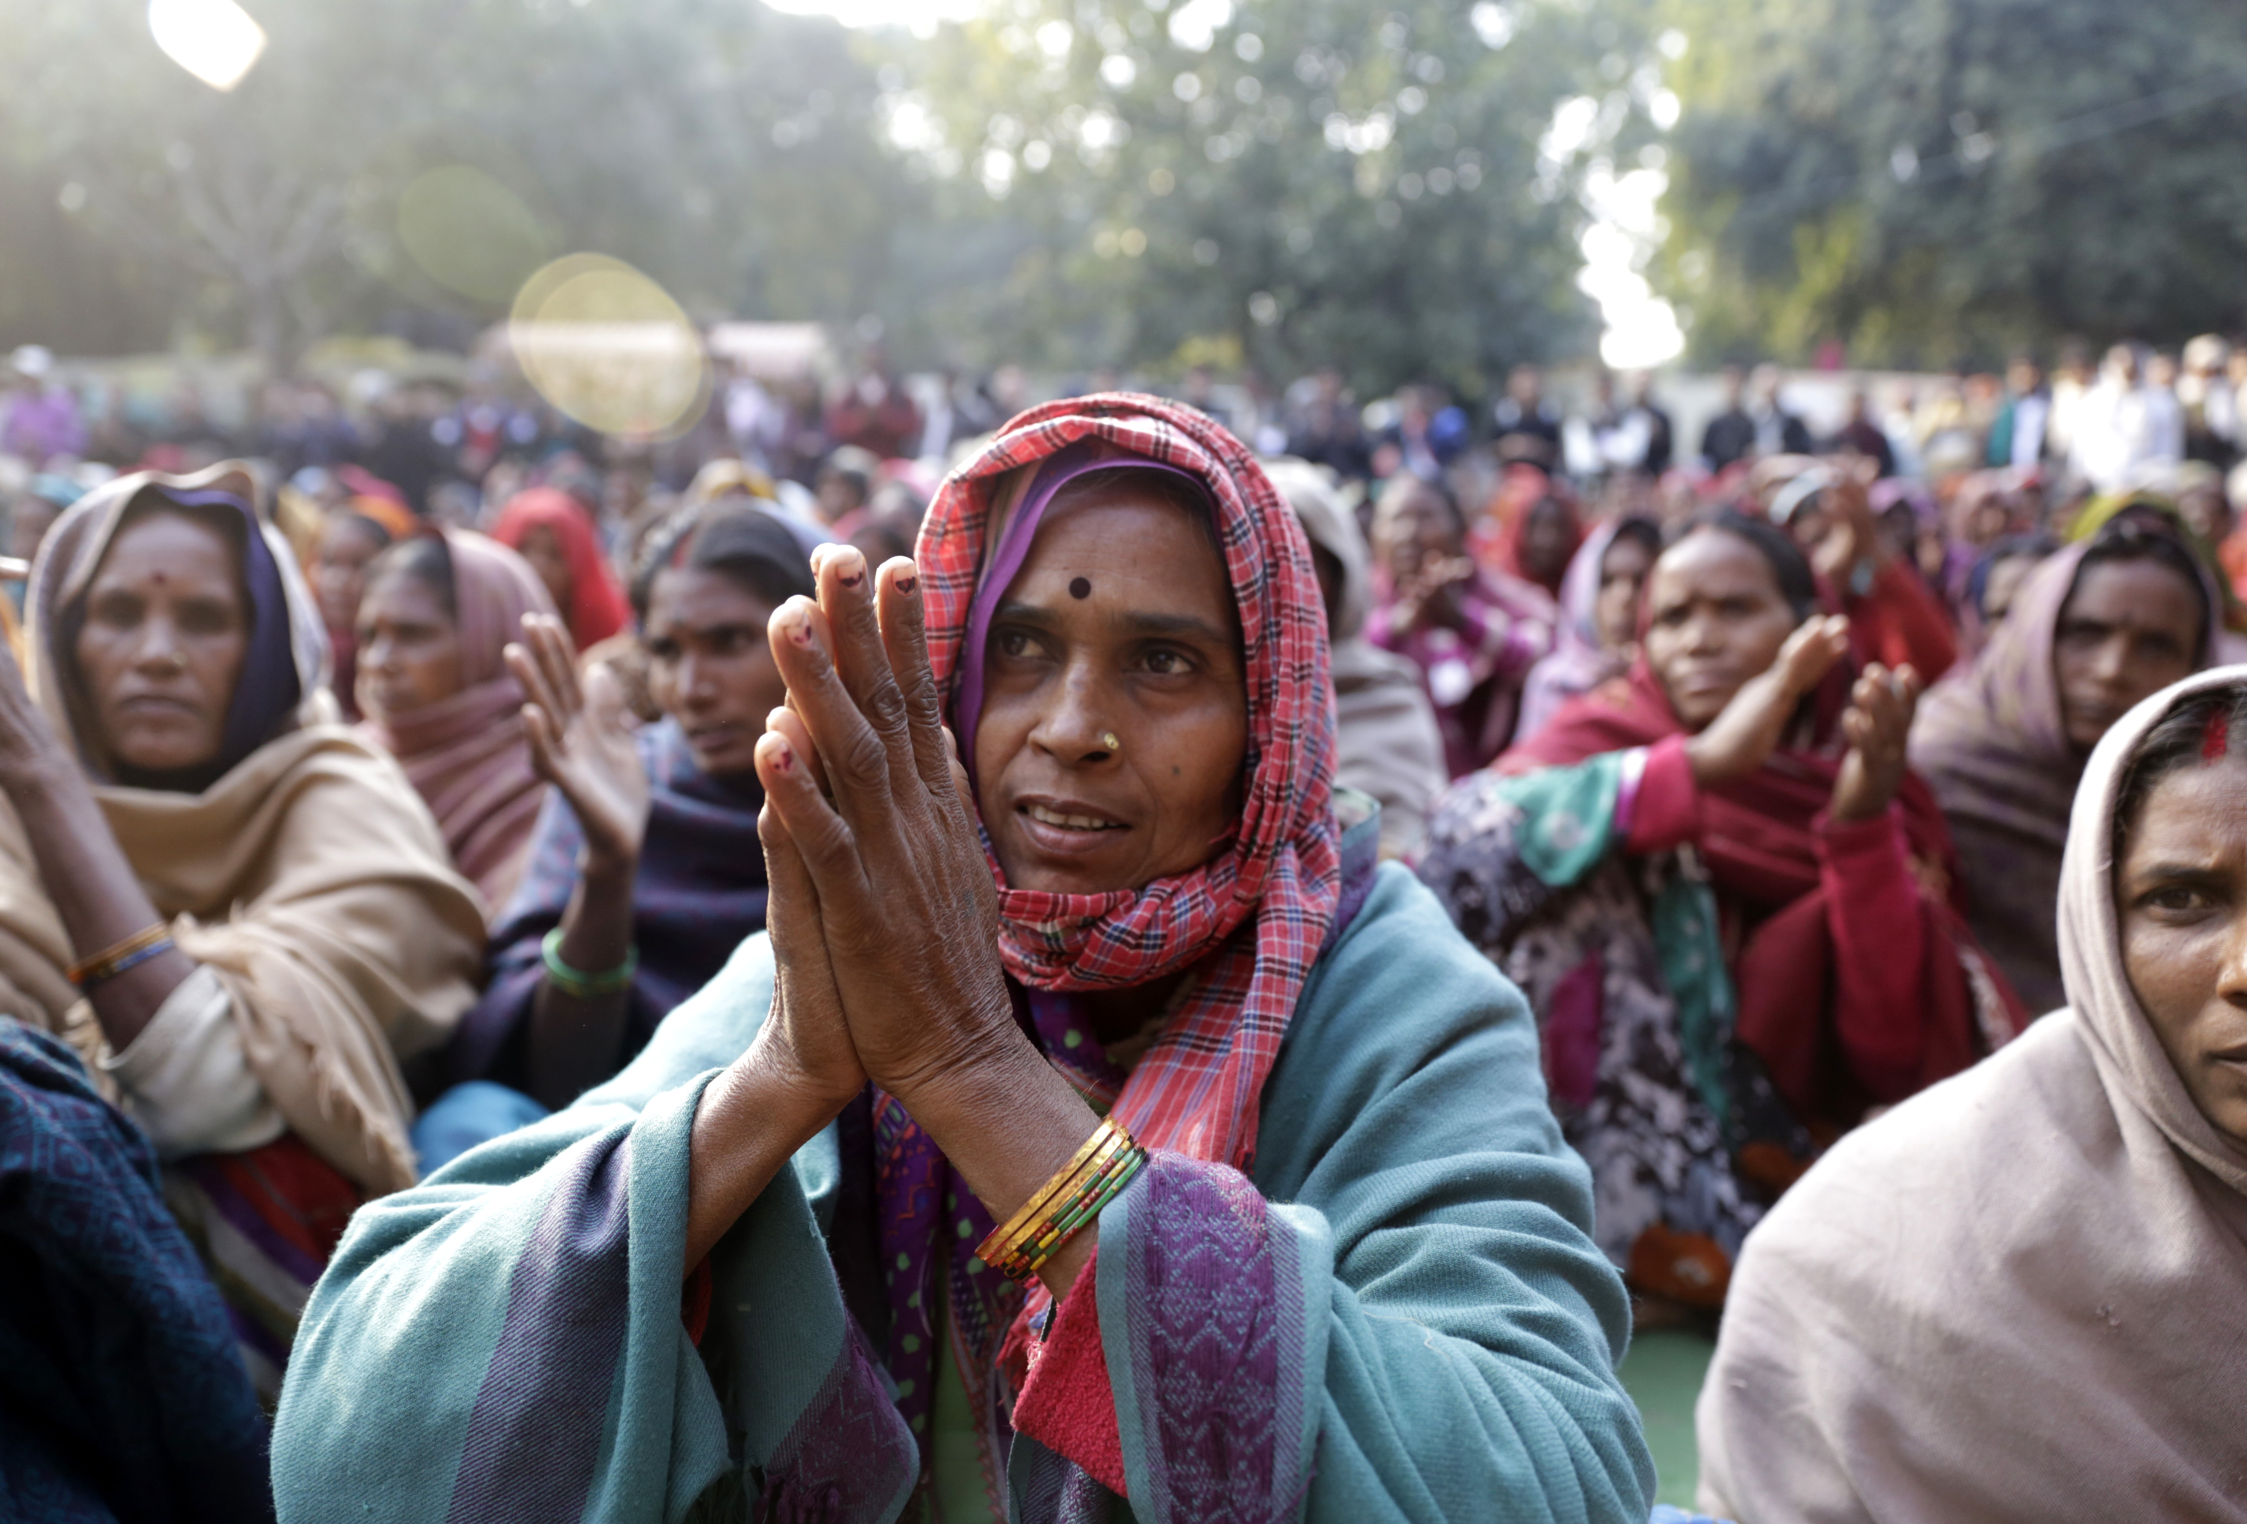
Indigenous peoples are disproportionately likely to experience obesity, which drives health inequities.

Slide 4
Indigenous peoples’ physical activities are shaped by colonialism, which has

Slide 5


I'm not the only one who thinks that the "critical" in critical theory is a bit of a misnomer.

Slide 6
This is a really good article. It's long, but it's worth the read. It's a good example of a critical ethnography, and it's a good example of how to do a critical ethnography. It's also a good example of how to do a qualitative analysis, and it's a good example of how to do a qualitative analysis that's informed by critical theory. The authors did a good job of explaining their methodology and their analysis, and they did a good job of explaining their findings. They also did a good job of explaining the limitations of their study. The authors also did a good job of explaining the limitations of their study. This is a good article.

Slide 7


get outside and move.

Slide 8
The more you move, the healthier you are.

Slide 9


I’m not sure if this is a good paper or not. I’m not sure if I’m a good reviewer or not. I’m not sure if I’m a good person or not.

Slide 10
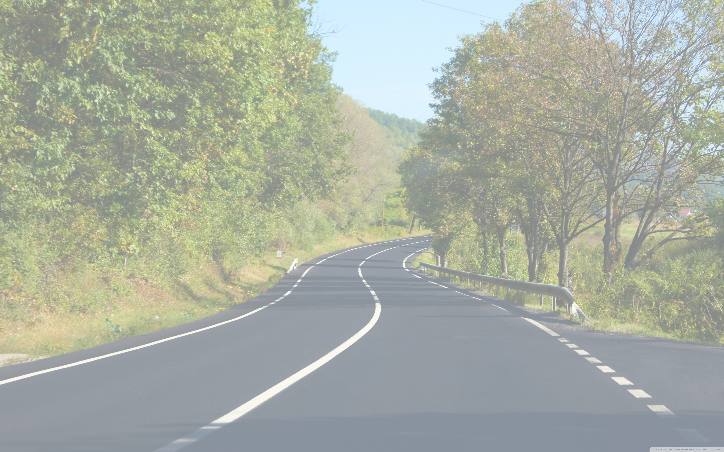
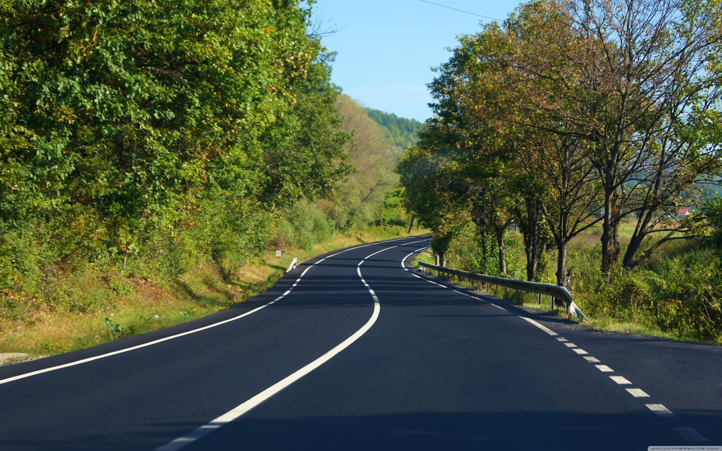
The way we cope with stress is influenced by our culture and environment.

Slide 11


Physical activity is good for you.

Slide 12


Indigenous health is bad.

Slide 13

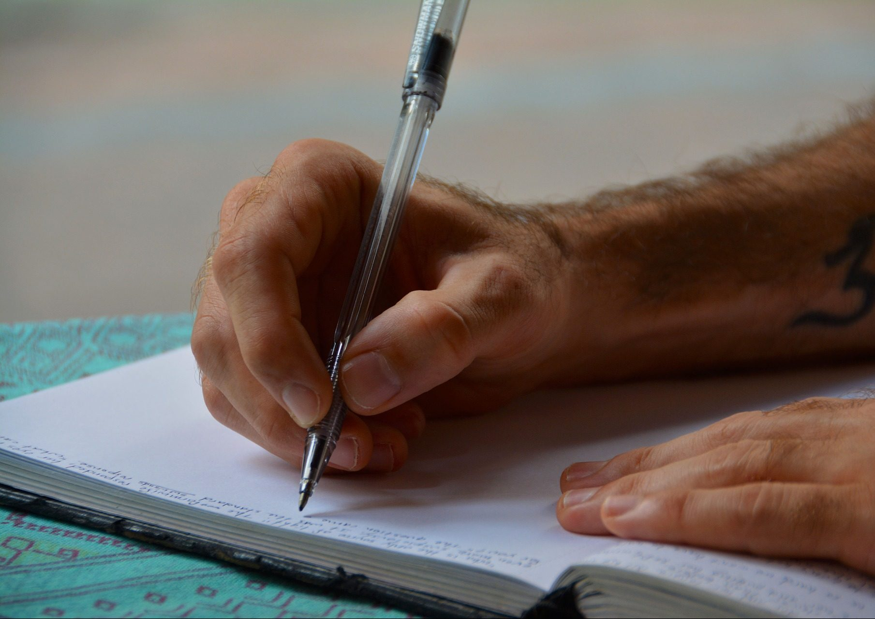
I'm going to be writing a lot about food, health, and social justice in the coming months. I'm also going to be doing a lot of reading and thinking about food, health, and social justice. I'm going to be posting a lot of stuff on my blog, and I'm going to be posting a lot of stuff on my Twitter. I'm going to be posting a lot of stuff on my Facebook, and I'm going to be posting a lot of stuff on my Instagram. I'm going to be posting a lot of stuff on my Medium, and I'm going to be posting a lot of stuff on my LinkedIn. I'm going to be posting a lot of stuff

Slide 14


This study is an excellent example of how to do qualitative research. It's a great example of how to think about the ethical implications of your research. It's also a great example of how to think about how to do a mixed methods study. I'm not sure how much I agree with the authors' conclusions, but I think they are well-reasoned and well-supported. I also think that the authors' conclusions are consistent with my own experience. I think that the authors' conclusions are also consistent with the literature. I think that the authors' conclusions are also consistent with my own experience. I think that

Slide 15
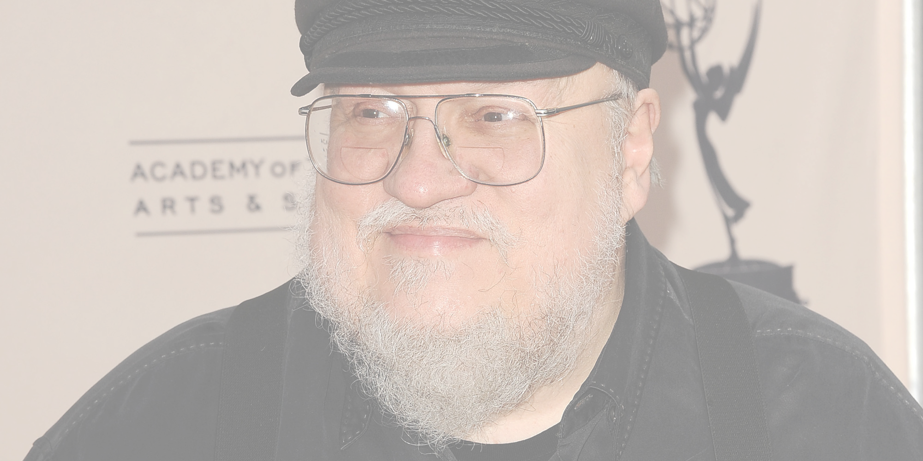
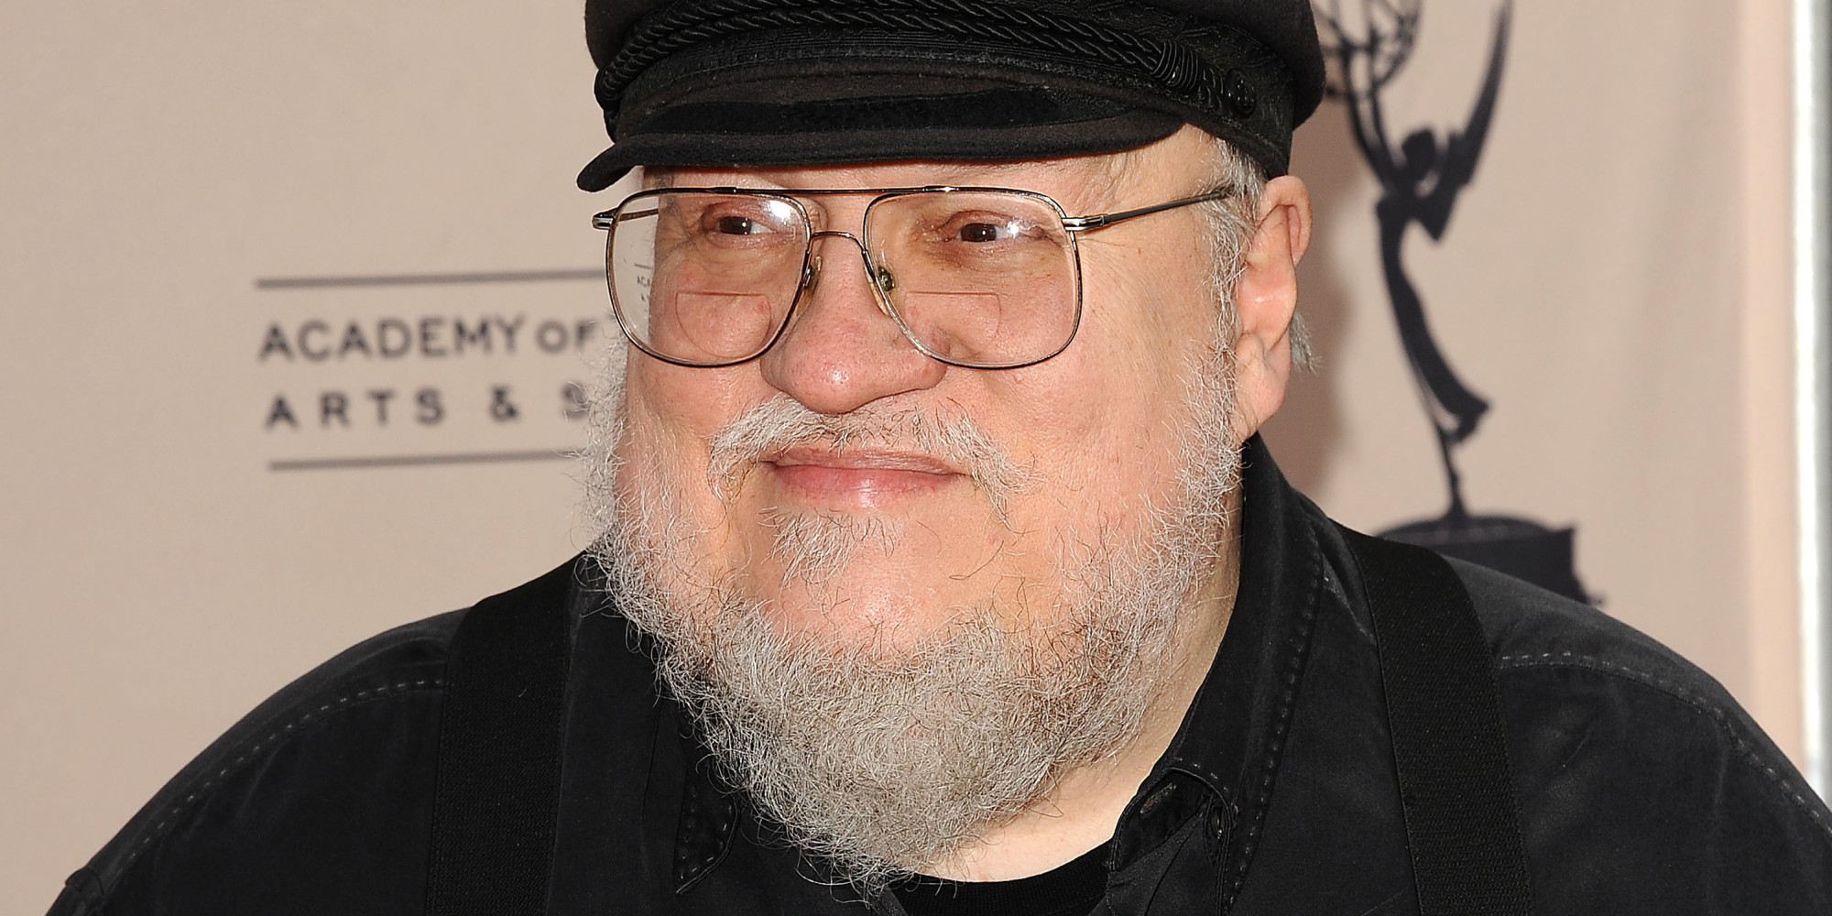
The authors found that the majority of qualitative participants were women, and that the majority of quantitative participants were men. The authors also found that the majority of qualitative participants were from rural areas, and that the majority of quantitative participants were from urban areas. The authors also found that the majority of qualitative participants were older, and that the majority of quantitative participants were younger. The authors also found that the majority of qualitative participants were married or in a domestic partnership, and that the majority of quantitative participants were not. The authors also found that the majority of qualitative participants had children, and that the majority of quantitative participants did not. The authors also found that the majority of qualitative participants had siblings, and that the majority

